Slide 1
Accessing the Curriculum for Diverse Learners
Universal Design for Learning

Slide 2
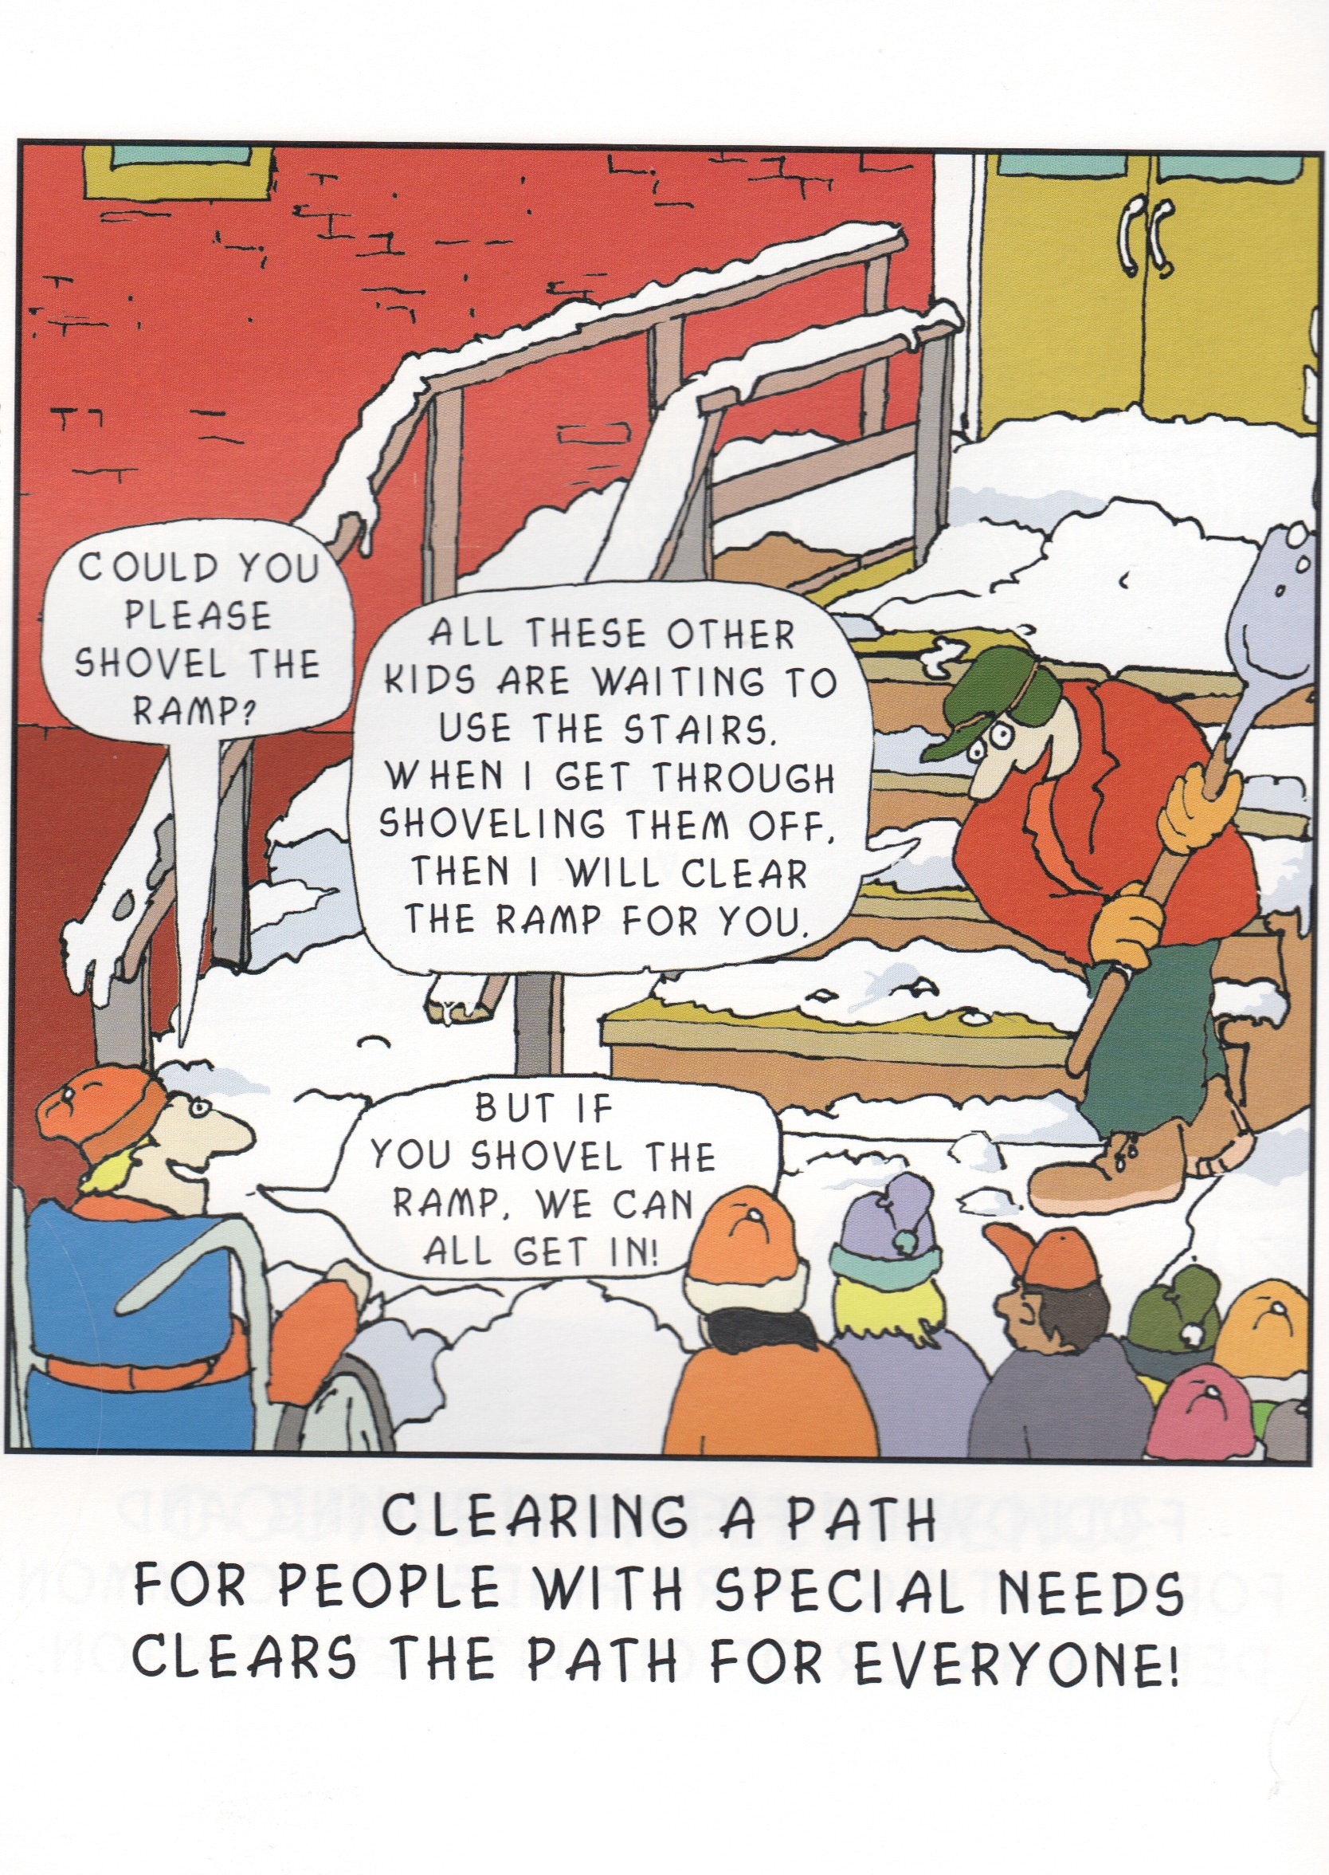
Activity: Cartoon Analysis

Slide 3
Universal Design = Access
"The term 'universal design' means a concept or philosophy for designing and delivering products and services that are usable by people with the widest possible range of functional capabilities, which include products and services that are directly accessible (without requiring assistive technologies) and products and services that are interoperable with assistive technologies."

Slide 4
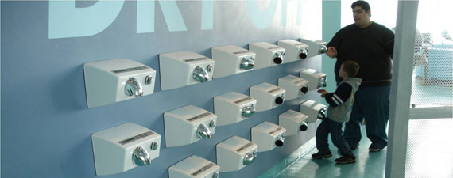
Universal Design
“the design of products and environments to be usable by the greatest extent possible by people of all ages and abilities” (Story, 1998)
Universal design puts high value on both diversity and inclusiveness.

Slide 5
What is Universal Design?
Not one size fits all – but alternatives for everyone.
Not added on later – but designed from the beginning.
Not access for some – but access for everyone.

Slide 6
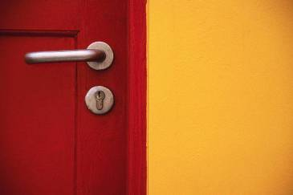
Universal Design
Curb Cuts
Ramps
Electric Doors
Captions on Television
Easy Grip Tools

Slide 7
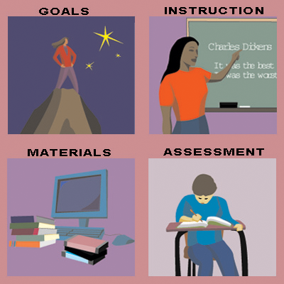
Universal Design of Learning (UDL)
A UDL framework assumes that students with varying needs will be involved in learning and that the curriculum needs to address this diversity. Core UDL Principle

Slide 8
Universal Design for Learning
Curricula and tools designed to meet the needs of all learners
Supports for diverse learners built in from the start
Frequently more effective for all learners, even “typically developing”

Slide 9
A Conceptual Shift
Diversity is the norm
Technology is flexible and accessible (when planned)
Focus on the curriculum – goals, assessments method, materials
Focus on student profiles and class profiles

Slide 10
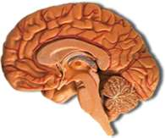
Based on Brain-research
How students learn:
Recognition Networks (the “what” of learning)
Multiple Means of Representation
Strategic Networks (the “how” of learning)
Multiple Means of Expression
Affective Networks – the “why” of learning
Multiple Means of Engagement

Slide 11
Towards Universal Design of Learning Environments Sensory - Physical
School | Classroom | Community
Wheelchair access Clear signs using both words and pictures Displays of student work that encourage looking, touching | Talking software and input devices Braille printout from computers Places for movement in the class Allowance for drink and food Clear labels for materials in the class with picture cues Spaces for wheelchair access | Accessible playground equipment Accessible public buildings and businesses

Slide 12
Towards Universal Design of Learning Environments Social - Emotional
School | Classroom | Community
-Welcoming place—student and staff greeters -Parent and community volunteers -Supportive and caring culture -Cheerful building with work of students highlighted | -Places to work together, or alone in privacy -Peer buddies -Circles of support -Student organizing & decorating the room -Classrooms filled with student work | -Local places that welcome students -After-school mentors and circles -After-school programs involving community members and parents

Slide 13
Towards Universal Design of Learning Environments Academics
School | Classroom | Community
-Student work all over the building -All staff support student learning -Accessible library and media center that offers materials at many different levels -Talking software, speech to text, scanners, etc. | -Books and other resources for different ability levels -Talking computer software -Multiple tools to use to express learning -Visual magnification devices available | -Mentors who read or do investigations with students -Community organizations that host student learning activities -Accessible playgrounds and museums

Slide 14
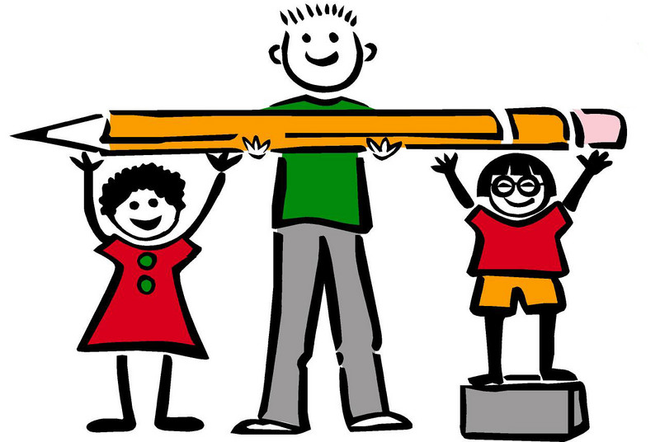
9 Principles of Universal Design for Learning
Equitable use (same means of use for all students)
Flexibility in use (choice in methods in use)
Simple and intuitive instruction
Perceptible information (communicated effectively for students of all abilities)

Slide 15
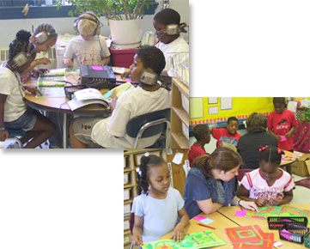
9 Principles of Universal Design for Learning
Tolerance for error
Low physical effort
Size and space for approach and use
Community of learners is promoted
Instructional climate (welcoming and inclusive)

Slide 16
3 core components of UDL curriculum
Multiple Means of Representation
provides flexibility in the ways students acquire and demonstrate information and knowledge
Multiple Means of Action & Expression
provides various ways students respond or demonstrate knowledge and skills
Multiple Means of Engagement
provides many ways for students to be engaged
Three Core UDL Principle

Slide 17

Video: UDL at a glance

Slide 18
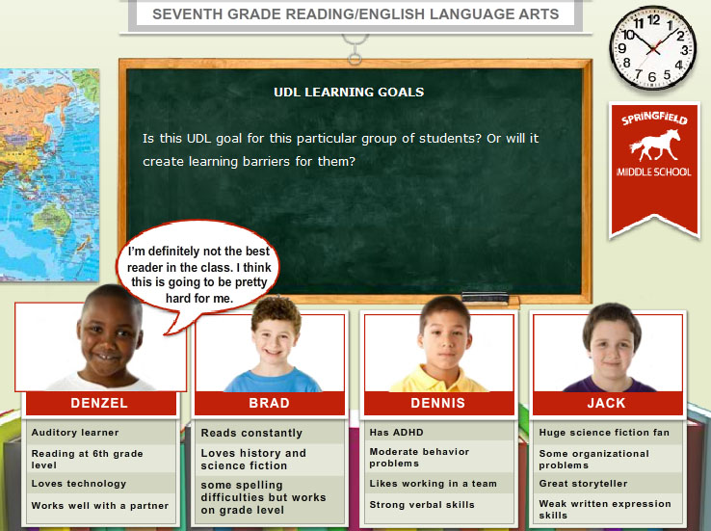
What is Universal Design for Instruction?
The design of instructional materials and activities that makes the learning goals achievable by individuals with wide differences in their abilities to see, hear, speak, move, read, write, understand English, attend, organize, engage, and remember” (Council for Exceptional Children)

Slide 19
Designing Inclusive Instruction
TIER III
Intensive Differentiation
for individual students
(5%)
TIER II
Individualized Differentiation – targeted group supports for at-risk students (15%)
TIER I
Universal Design for Learning – all students (80%)

Slide 20
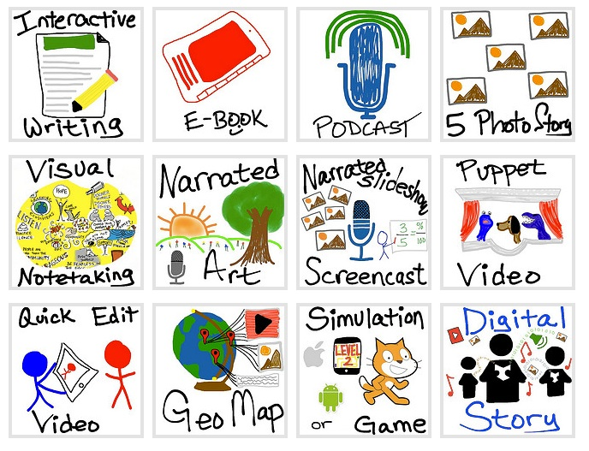
Differentiated Instruction
Curriculum (content and multiple ways to present information)
Process (multiple ways for accessing and expressing)
Product (multiple ways in which to to demonstrate / represent learning)
Based on the students interest, profiles and readiness

Slide 21
Video: UDL Guidelines in Practice

Slide 22

Article: scenario
Identify:
ways to present information
Ways to access and to express
Ways to demonstrate / represent learning
What will the EA be doing to support the teacher and the students?

